Slide 1

Henrico County
Small Lot Housing
April 2025
Virginia Housing Commission

Slide 2
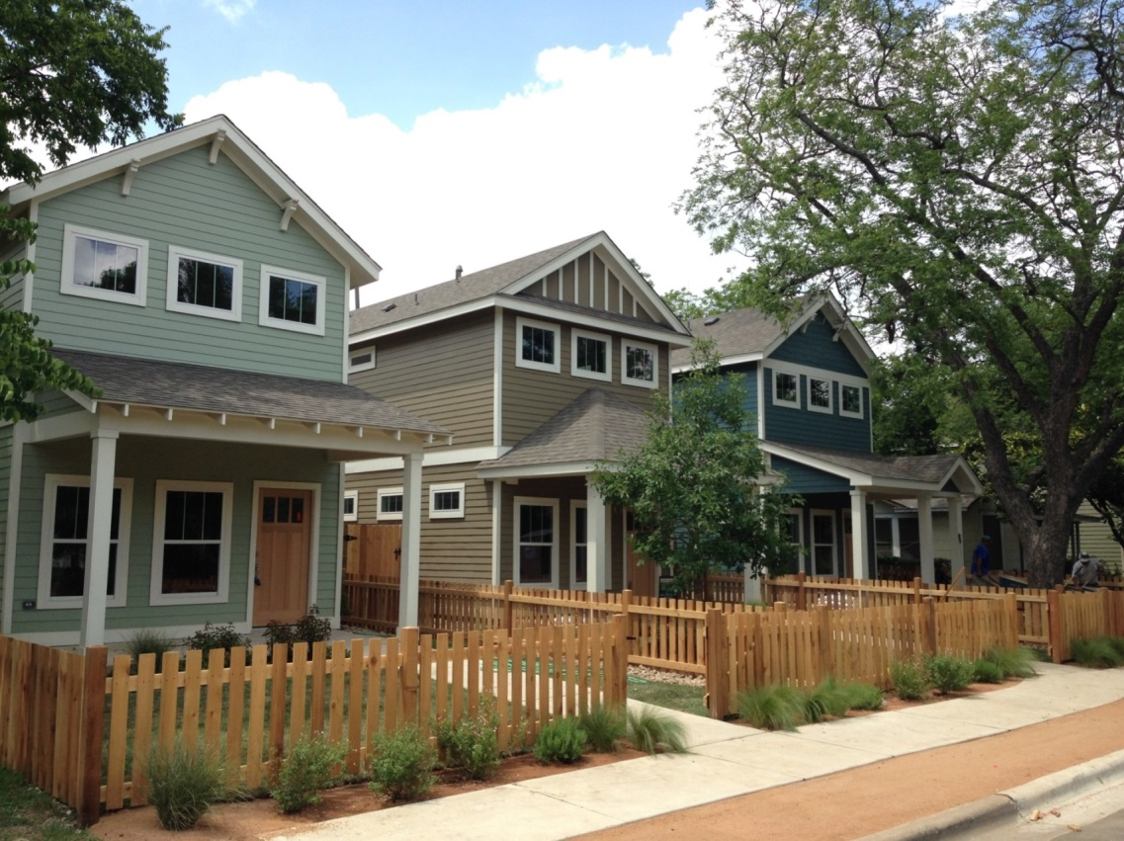
Housing
Options
Housing
Opportunities

Slide 3
Existing Ordinance Options - Detached
Benefits:
Ownership opportunities
Supported by market trends
Private open space
Consistent with past development patterns
Challenges:
Increased costs
Inefficient use of land in urbanizing areas
Larger homes in denser communities impact design
Barriers to efficient multimodal transportation

Slide 4
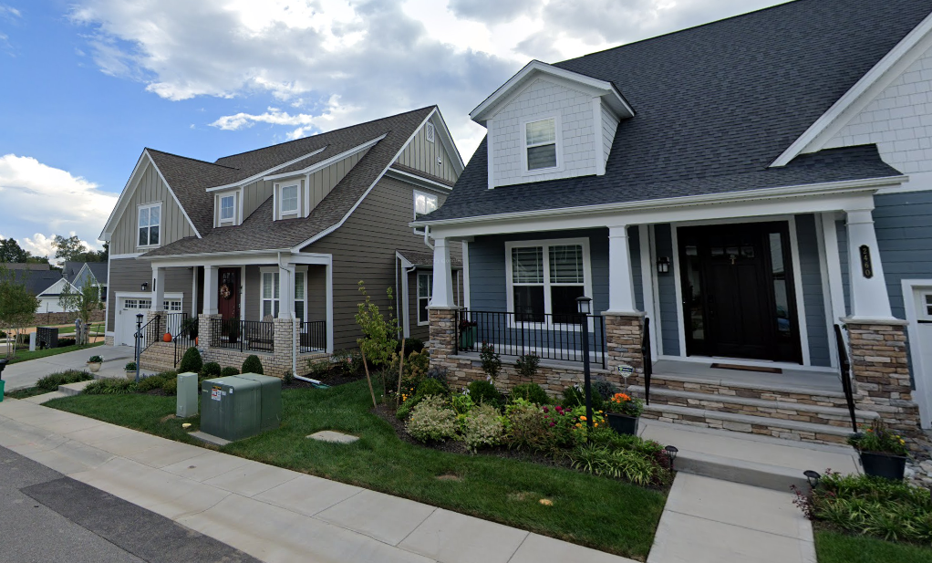
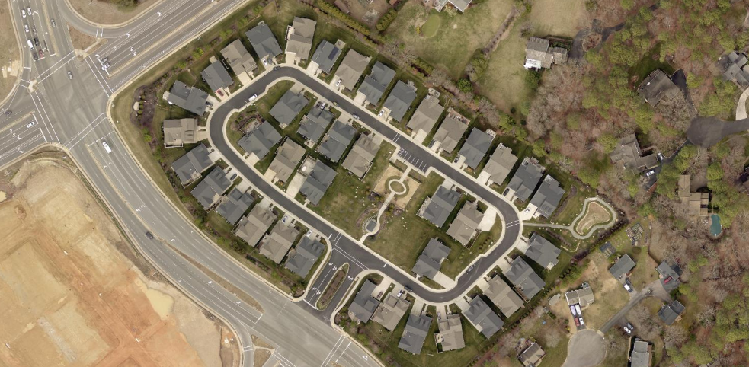
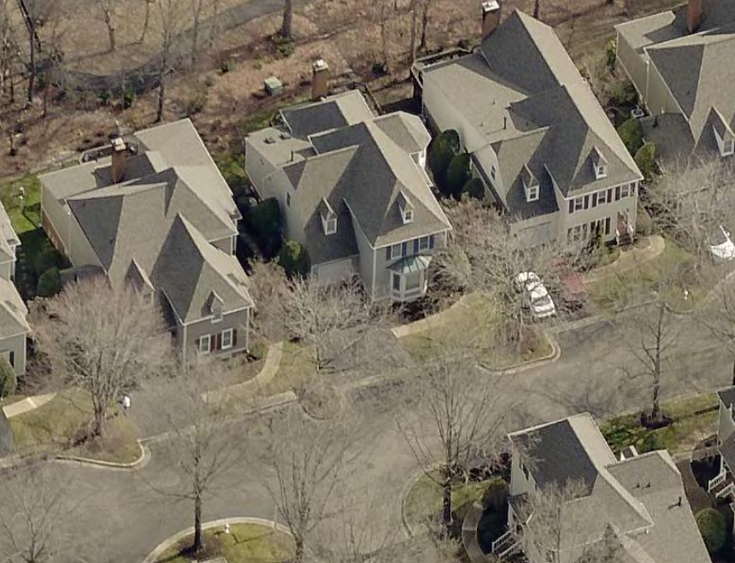
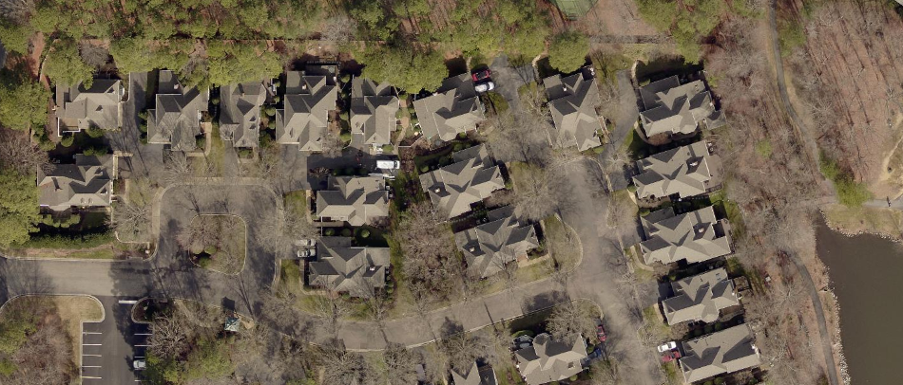
Existing Ordinance Options – Detached Condos
Benefits:
Can create transition between existing detached and attached communities
Greater design flexibility
Appearance of single family with shared maintenance for consistent appearance
Challenges:
Condominium ownership structure can be costly and challenging to finance
High ongoing costs for funding condominium obligations

Slide 5
Existing Ordinance Options - Attached
Benefits:
Increased ownership opportunities
Density yield greater for infill site
Generally easier to finance and develop due to incremental nature of construction
Challenges:
Can be more inconsistent with existing pattern of development
Requires shared wall construction
Can increase construction costs

Slide 6
Reintroduced Options – R-3A, R-4, and R-4A
Districts reintroduced with 2021 Code Amendments
Previously allowed prior to prohibition of new rezonings in 2000
Narrower single-family lots can match context of existing development for infill projects
Rezoning required for new developments
Only 2 rezonings approved since reintroduction

Slide 7
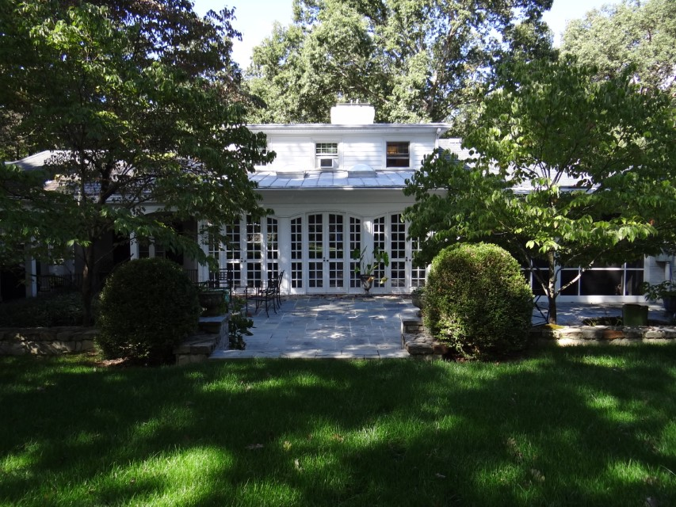
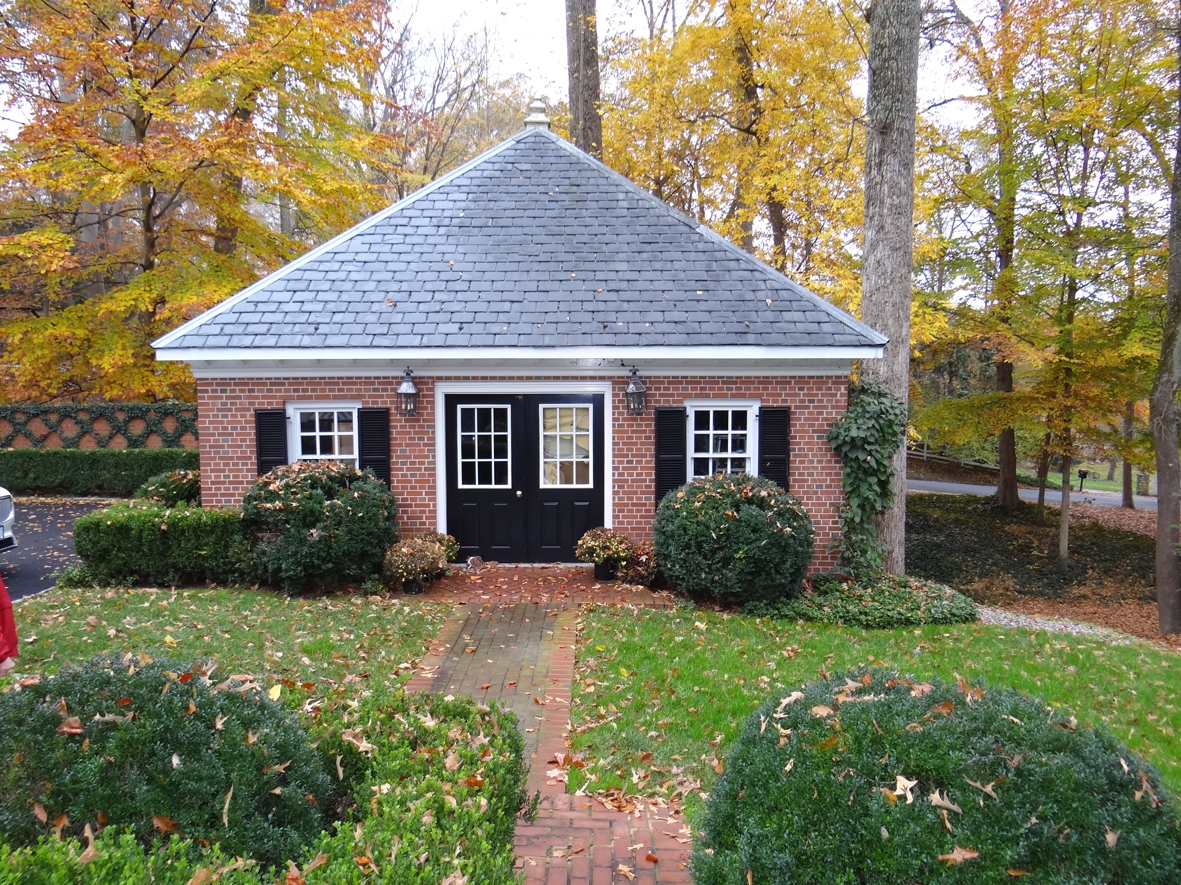
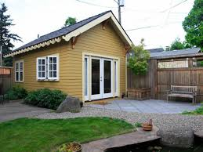
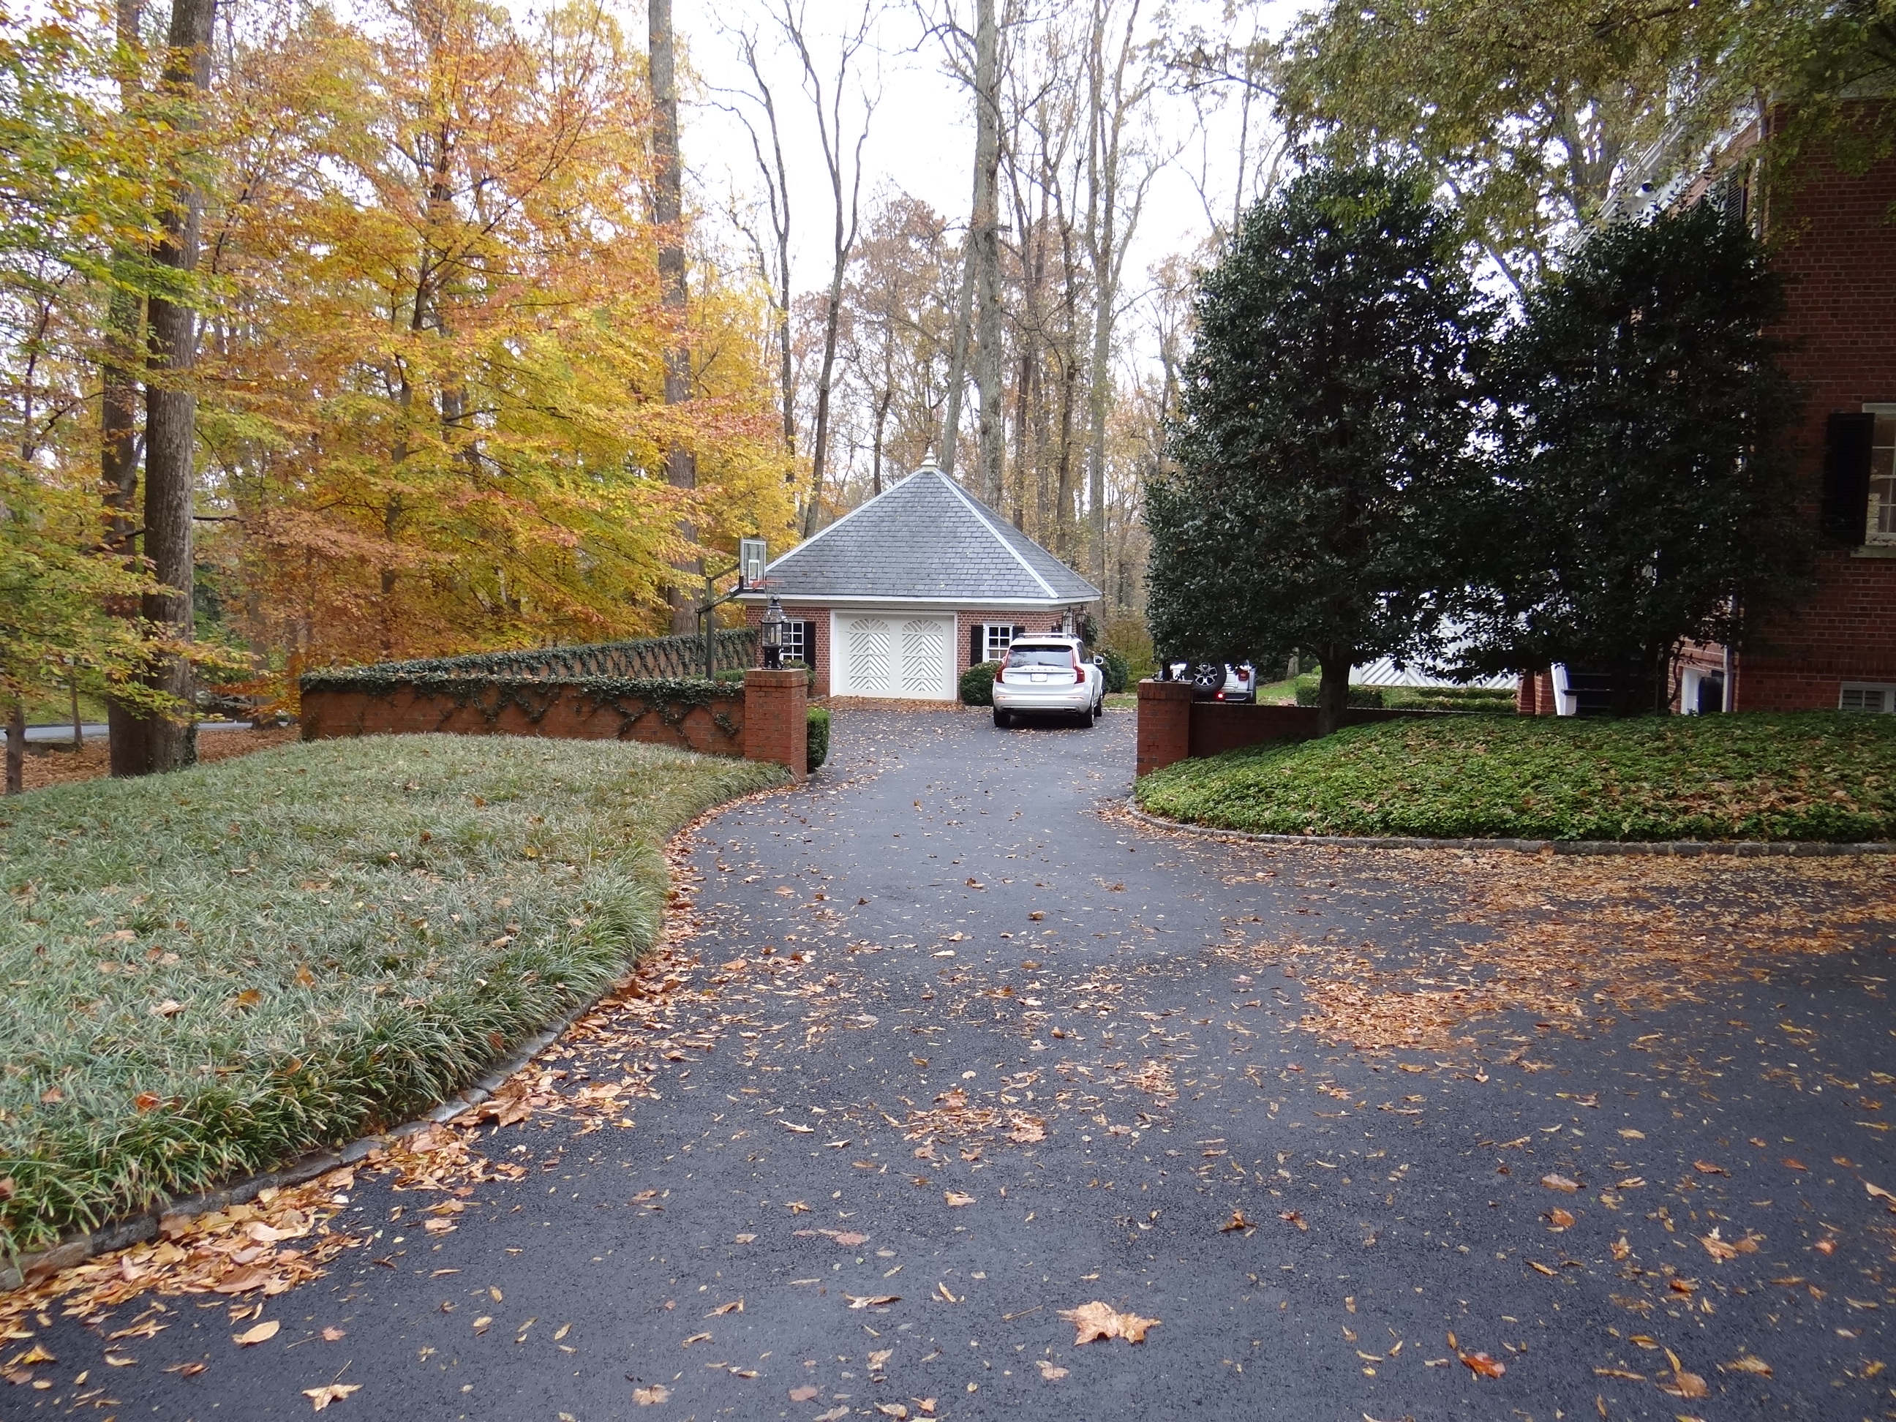
Newly Introduced Options – Accessory Dwelling Units (ADUs)
Conditional Use Permit process through Board of Zoning Appeals
  20 approved as of March 2025
Option was added consistent with changes to Code of Virginia
Allows public input process – minimal concerns from neighbors to this point
Provides opportunity for expanded family living options and affordable units for others
Some difficulty in administration – determination of accessory, appropriate size and measurement

Slide 8
What Opportunity is Missing?
?

Slide 9
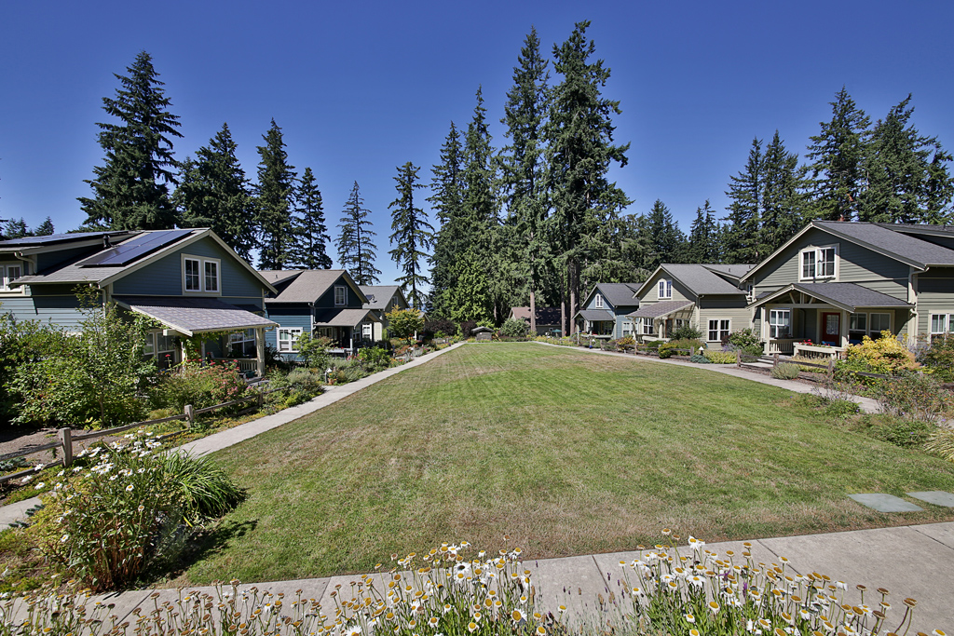
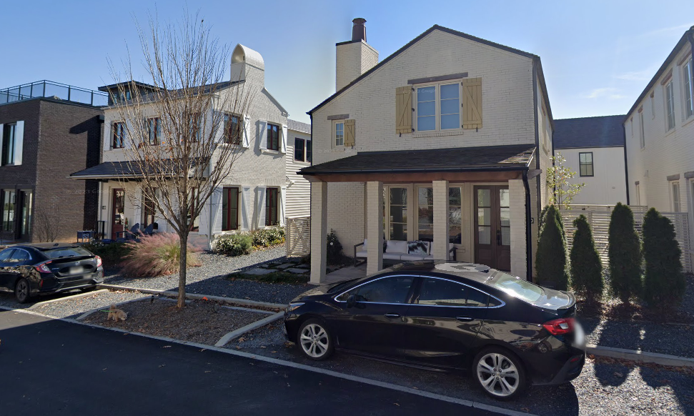
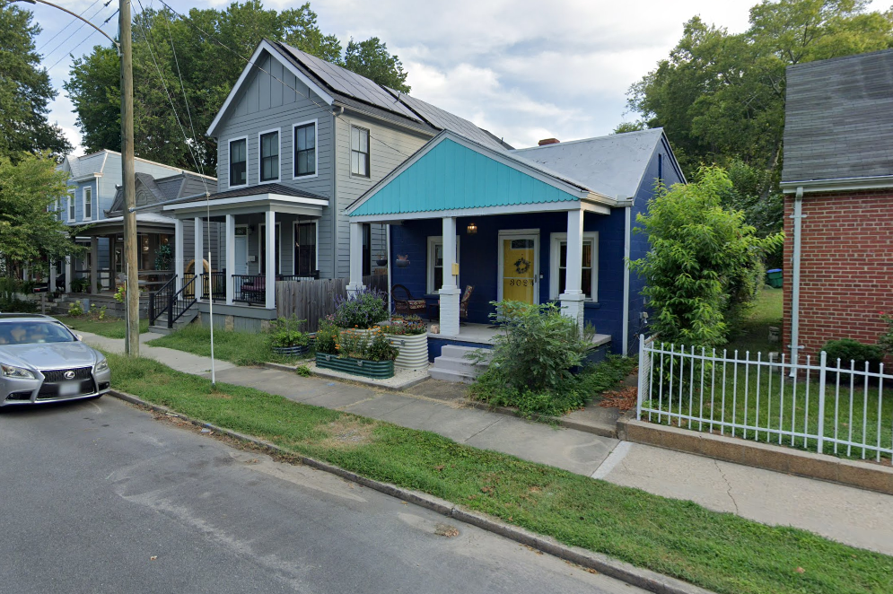
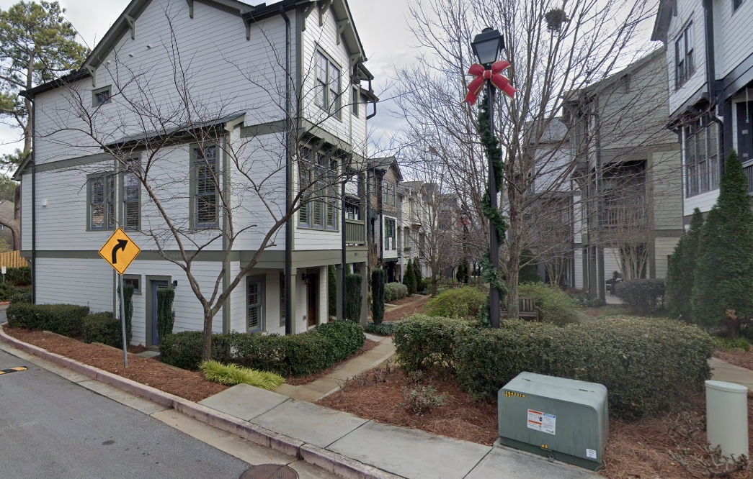
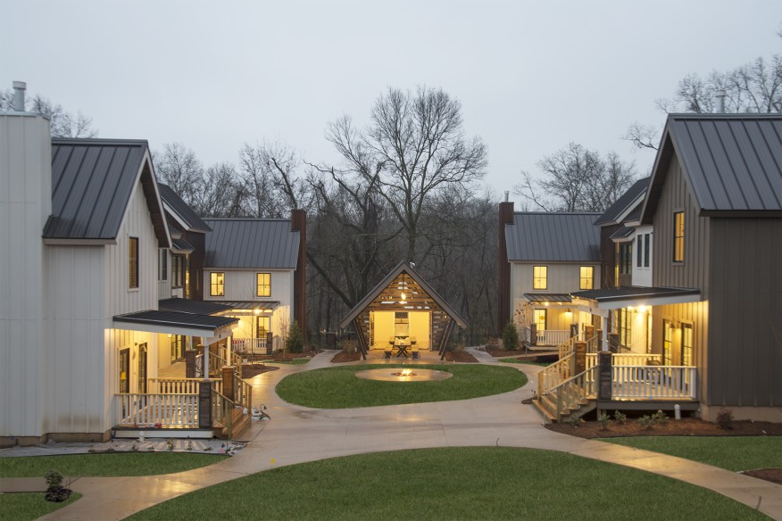
Research Opportunities Used Elsewhere
Best Practice Research:
Locations:
City of Richmond
Raleigh, NC
Austin, TX
Falls Church, VA
Langley, WA
Decatur, GA
Fayetteville, GA
Review:
Lot standards
Design requirements
Infrastructure flexibility
Responsibility for maintenance

Slide 10
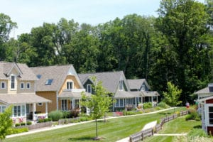
New Opportunity:
R-5B General Residence District
Benefits:
Smaller lots with reduced setbacks could decrease development costs
Allow additional density while increasing consistency with existing pattern of development
Challenges:
Home design becomes greater focus
Requires rezoning
Development savings may be offset by need for additional shared infrastructure like lighting and shared open space
No guarantee that housing will be affordable

Slide 11
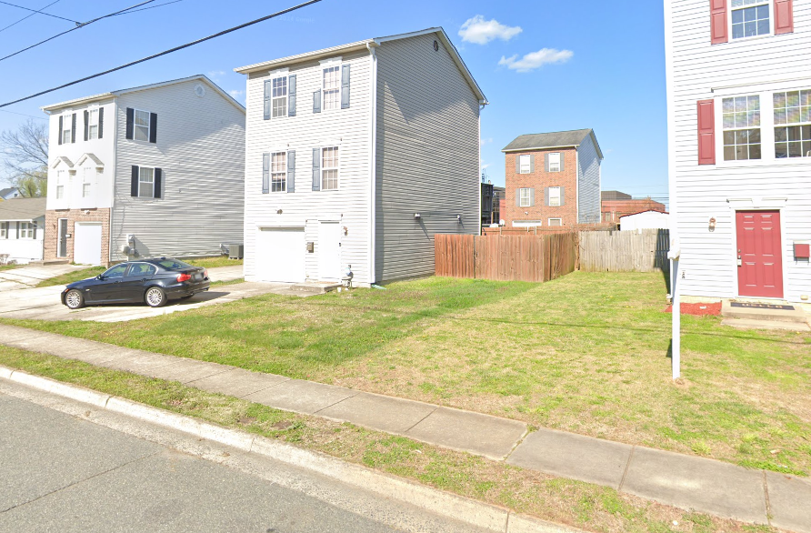
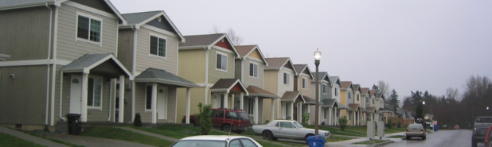
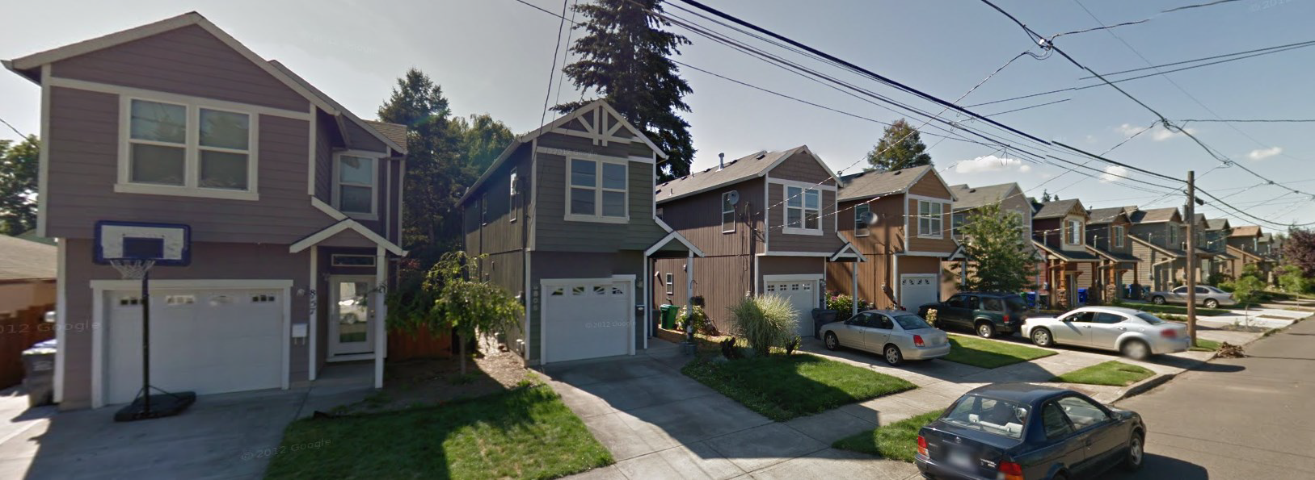
Design Considerations Can Arise
Challenges:
Location of parking
  Garages
  Driveways
  Street parking
Repetition of design
Emphasizes height

Slide 12
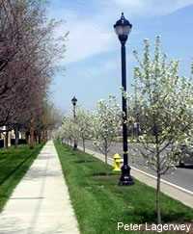
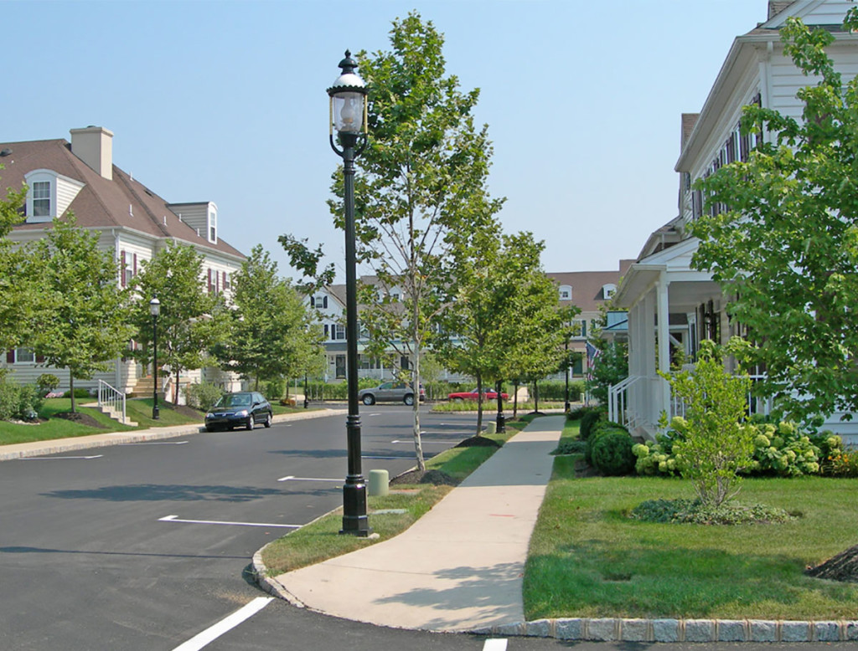
Preferred Design Can Increase Costs
Affordability Inputs:
Land
Infrastructure
  New roads/alleys
  Extension of utilities
  Sidewalks
  Lighting
  Open Space
Environmental
  Stormwater management
  Floodplain
  Wetlands
Soft costs
  Approval process
  Engineering
  Financing
Building materials
  Enhanced design
  Fire code requirements

Slide 13
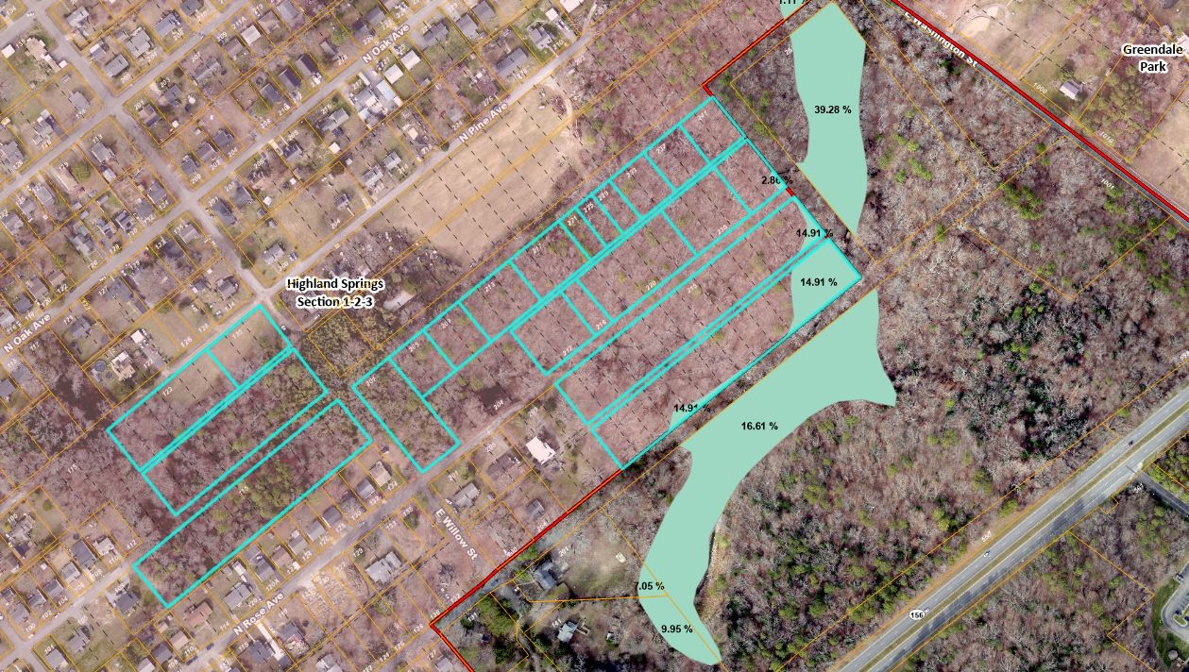
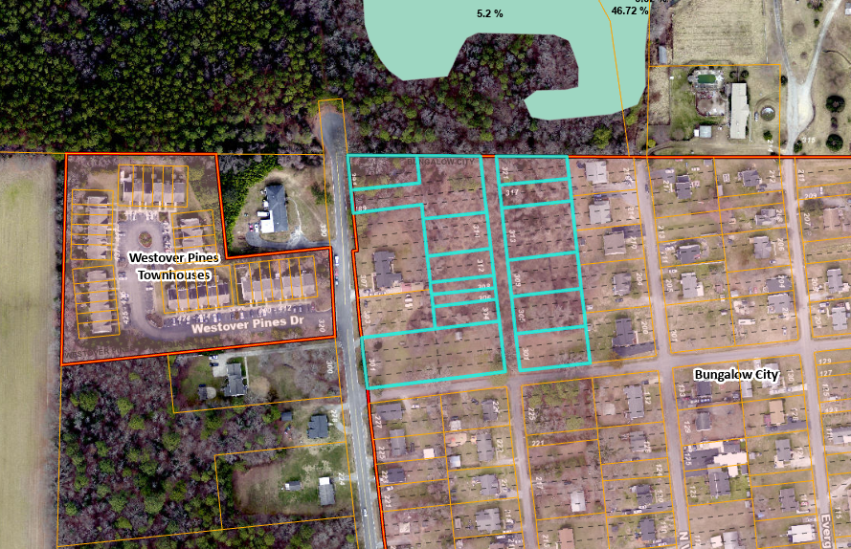
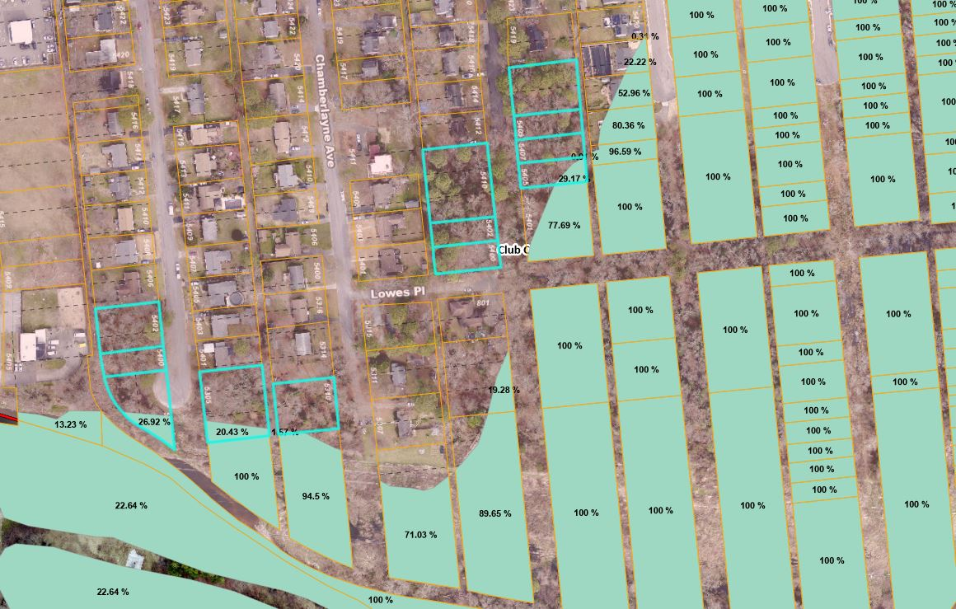
Can Existing Smaller Lots Assist?
Subdivisions:
Highland Springs
Federal Place
Club Court
Bungalow City
Initial Review:
Lots range from 25’ to 40’ wide
Typically combined into larger parcels
Indicated almost 200 lots that should be further explored in these subdivisions; more countywide

Slide 14
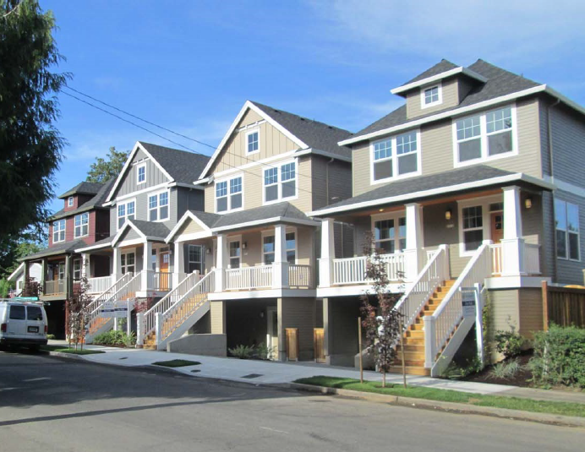
What Would Be Needed?
Development Hurdles:
Paper streets – no built infrastructure
Environmental considerations
Design guidelines
Ordinance Amendments:
Reduce required width for existing lots in certain districts
Setback reductions
Public road frontage requirements
Rezoning Considerations:
Addressing neighborhood concerns regarding consistency
Provide guidance as part of HenricoNEXT

Slide 15
Amended zoning ordinance to include R-5B General Residence District
Researching existing narrow (25’) lots to prioritize according to developability
Explore county-funded infrastructure improvements that would allow existing lots to be developed
Incorporate housing opportunities and affordable housing strategies in updated Comprehensive Plan
Ongoing Steps to Create More
Opportunities

